Slide 1

DATABASE SYSTEMS (EIE36E): Automatic values for a column in ORACLE DB
Doc. Ing. Václav Vostrovský Ph.D.
Ing. Petr Hanzlík

Slide 2

Outline > Database trigger
Auto-increment example in ORACLE DB
Database SEQUENCE
Database TRIGGER
TRIGGER: Event
TRIGGER: Restriction
TRIGGER: Action

Slide 3
Entity integrity
Each entity must be differentiable from others
What about ensuring this internally by generating attribute values automatically?

Slide 4
Database objects: Sequence
Sequence is a type of special database object used for generating unique integers
ORACLE sequence object syntax:
Defaults:
INCREMENT BY 1, NOMAXVALUE, CACHE 20
CREATE SEQUENCE <seq_name>
START WITH <start_number>
[INCREMENT BY <step_size>]
[MAXVALUE <max_value>]
[CACHE <values_in_cache>]
Notes:
MAXVALUE
CACHE minium = 2, NOCACHE
NOORDER – generate the numbers of sequence in no specific order

Slide 5

Entity integrity: Sequence example
Create a table with automatically generated ID
CREATE TABLE t (c1 NUMBER PRIMARY KEY, c2 VARCHAR2(10));
CREATE SEQUENCE t_seq
START WITH 3
INCREMENT BY 2
CACHE 10;
INSERT INTO t VALUES (t_seq.nextval,'anystrign');
INSERT INTO t VALUES (t_seq.nextval,'anystrign1');
SELECT * FROM t1 ORDER BY c1;
IS THAT THE SOLUTION WE WANT?

Slide 6
Database Triggers
TRIGGER is procedural code that is automatically executed in response to certain events on a particular table or view in a database
DATABASE TRIGGER structure:
The Triggering Event or Statement
Trigger Restriction
Trigger Action

Slide 7
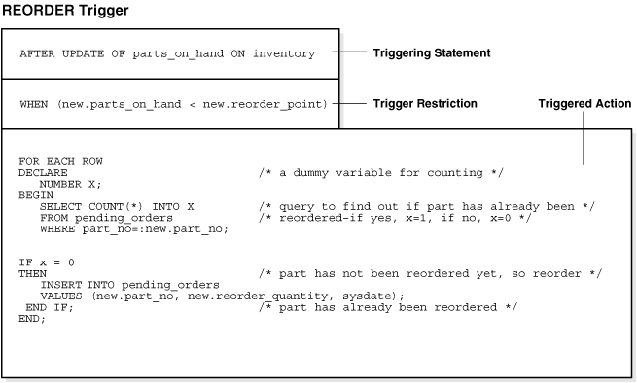
Database Triggers

Slide 8
Triggering event
The SQL statement, database event, or user event that causes a trigger to fire
An INSERT, UPDATE, or DELETE statement on a specific table
A CREATE, ALTER, or DROP statement on any schema object
A database startup or instance shutdown
…

Slide 9
Trigger restriction
A trigger restriction specifies a Boolean expression that must be true for the trigger to fire. The triggered action does not run if the trigger restriction evaluates to false or unknown.

Slide 10
Triggered action
A trigger action is the procedure (PL/SQL block, Java program, etc.) that contains the SQL statements and code to be run when the following events occur:
A triggering statement is issued.
The trigger restriction evaluates to true.

Slide 11
Triggered action
Row Triggers and Statement Triggers
BEFORE and AFTER Triggers
Compound Triggers
INSTEAD OF Triggers
Triggers on System Events and User Events

Slide 12
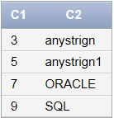
Trigger: example
Trigger that automatically increments ID on insert
CREATE TRIGGER t_trigger
BEFORE INSERT ON t1
FOR EACH ROW
BEGIN
SELECT t_seq.nextval INTO :new.c1 FROM DUAL;
END;
INSERT INTO t1 (c2) VALUES ('ORACLE');
INSERT INTO t1 (c2) VALUES ('SQL');
SELECT * FROM t1;

Slide 13
Database Objects
Triggers and sequences are standard database objects, thus it is possible to manipulate them in a standard way:
// remove objects
DROP SEQUENCE <sequence_name>;
DROP TRIGGER <trigger_name>;
// show existing object from system tables
SELECT * FROM user_sequences;
SELECT * FROM user_triggers;
// enable x disable trigger execution
ALTER TRIGGER test_trigger DISABLE;
ALTER TRIGGER test_trigger ENABLE;

